Slide 1
LeSueur’s process
The process uses Lunge’s apparatus. The cathode, of iron wire gauze is placed in a slanting position. On it rests the diaphragm, consisting of two parts, a sheet of parchment paper and it double sheet of asbestos cemented together by blood albumin, coagulated and hardened by treatment with potassium bichromate. An earthenware bell enclosed the anode, which was made of lead, carrying carbon rods dipping into the salt solution. Caustic soda is formed in the solution outside the bell, and owing to the inclined position of the cathode, the hydrogen was expected to escape readily, thus preventing polarization. But it proved in practice that the earthenware bells were disintegrated by the caustic soda solution, while the hydrogen set free. The diaphragms are rapidly destroyed, lasting only from 24 to 48 hours. The anodes are consumed more slowly, lasting about six weeks. The process yields a solution of caustic containing 10 per cent NaOH.

Slide 2
LeSueur’s process
Hydrogen:
name | spec | range | price
MSG-MQ-8H | Ov: 5V | 100-10000ppm | Rs.400.00
NTM SenseH2 | Ov:12-24V | 0.25 to 4.0% conc. | $530.00

Slide 3
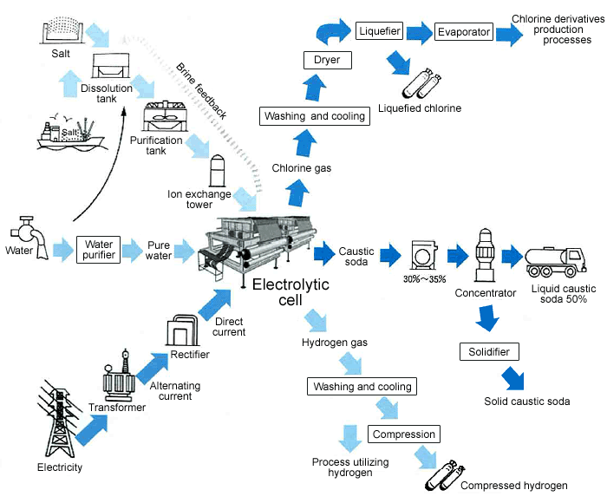
Membrane process

Slide 4
Membrane process
working:
The brine in the anode chamber contains sodium (Na+) and chloride (Cl-) ions. These ions migrate when a current is applied: the positively charged sodium ions pass through the membrane to the cathode chamber, while the negatively charged chloride ions are discharged on the anode surface to form chlorine gas (Cl2).
Water in the cathode chamber partly dissociates into hydrogen (H+) and hydroxide (OH-) ions. The hydrogen ions capture electrons on the cathode surface to form <<hydrogen gas (H2)>>. The hydroxide ions are attracted to the anode, but blocked by the membrane, and react with the sodium ions from the anode chamber to form <<caustic soda (sodium hydroxide, NaOH)>>.

Slide 5
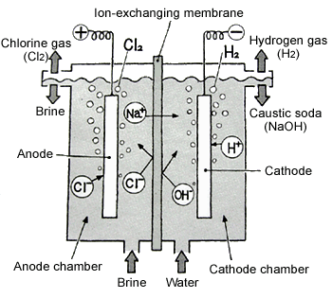
Membrane process
Hydrogen gas
Chlorine gas

Slide 6
Membrane process
Cl sensor
name | spec | range | price
CCS51D | 25 mm diameter | 0 - 200 mg/l | --
DULCOTEST | 4-20 mA signal | 0.02 – 2 mg/l | --

